Slide 1
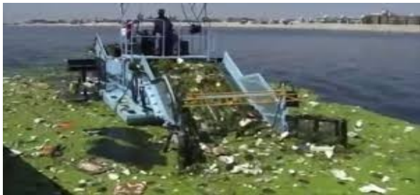

River Cleaning Robot
present by :
vamsikrishna AM

Slide 2

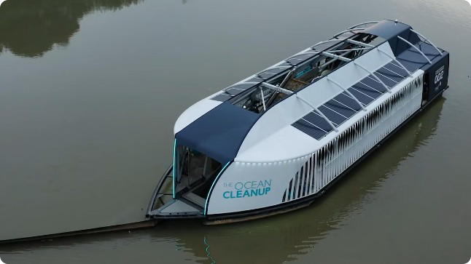
Introduction to the River Cleaning Robot
Introducing our innovative river cleaning robot, designed to tackle the pressing issue of polluted waterways. This state-of- the-art machine harnesses advanced technology to efficiently and sustainably remove waste from rivers, lakes, and other aquatic environments.

Slide 3

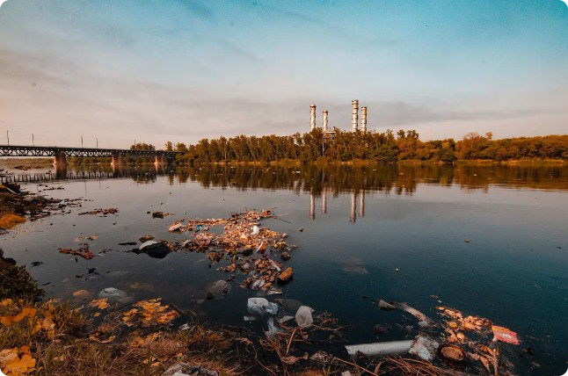
The Problem: Polluted Waterways
Plastic Waste
Plastic pollution is a significant threat to aquatic ecosystems, endangering wildlife and disrupting delicate food webs.
Chemical Runoff
Industrial and agricultural runoff can introduce harmful chemicals and toxins into waterways, compromising water quality and ecosystem health.
Debris Accumulation
Floating debris and sunken waste can obstruct waterways, hampering water flow and navigation.

Slide 4


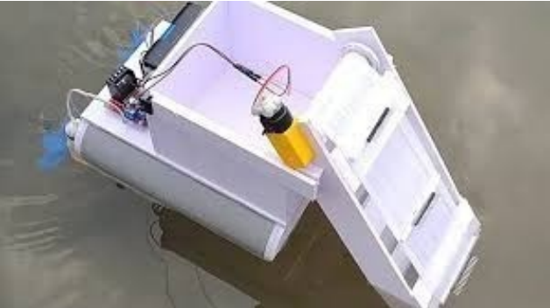
Our Solution: Automated River Cleanup
1
Efficient Waste Removal
The robot's advanced filtration system and specialized tools quickly and effectively remove a wide range of pollutants from the water.
2
Autonomous Operation
With its self-navigating capabilities, the robot can operate independently, optimizing coverage and minimizing human intervention.
3
Environmentally Friendly
Powered by renewable energy, the robot minimizes its carbon footprint and preserves the delicate balance of aquatic ecosystems.

Slide 5
Key Features of the Robot
Versatile Waste Capture
Advanced Sensors
Durable Design
The robot's multi-purpose collection system can handle a variety of pollutants, from plastic waste to organic debris.
Onboard sensors continuously monitor water quality, enabling the robot to adapt its cleanup strategies in real-time.
Built to withstand harsh aquatic environments, the robot's sturdy construction ensures reliable and long-lasting performance.

Slide 6

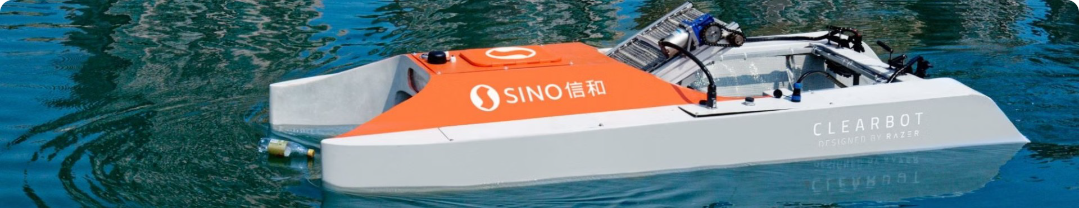
Cleaning Mechanism and Efficiency
1
Dual-Stage Filtration
The robot's advanced filtration system combines coarse and fine filters to capture a wide range of pollutants.
2
Intelligent Navigation
Utilizing GPS and sonar technology, the robot navigates waterways efficiently, ensuring comprehensive coverage.
3
High Throughput
The robot's powerful propulsion system and optimized cleaning mechanisms enable it to process large volumes of water quickly.

Slide 7
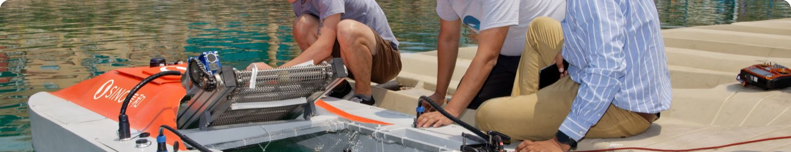



Environmental Impact and Benefits
Ecosystem Restoration
By removing pollutants, the robot helps to revitalize aquatic habitats and support the recovery of local wildlife.
Improved Water Quality
Cleaner waterways mean safer drinking water, recreation, and irrigation for surrounding communities.
Reduced Carbon Footprint
The robot's eco-friendly design and renewable energy source minimize its environmental impact.

Slide 8


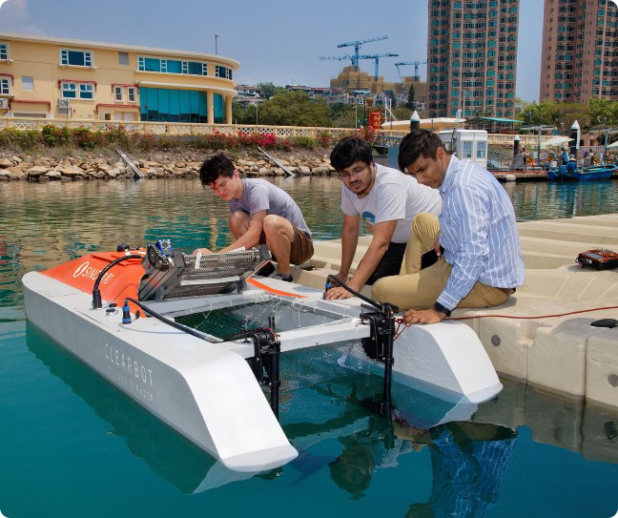
Deployment and Operation
Site Assessment
Carefully evaluating the target waterway to determine the optimal robot deployment strategy.
Autonomous Navigation
The robot navigates the waterway, continuously adjusting its course to ensure comprehensive coverage.
Remote Monitoring
Advanced telemetry allows operators to monitor the robot's status and performance in real-time.

Slide 9


Maintenance and Servicing
Component
Servicing Interval
Procedure
Filtration System
Monthly
Cleaning and replacement of filters
Propulsion System
Quarterly
Inspection and lubrication of moving parts
Sensors and Electronics
Bi-annually
Calibration and software updates

Slide 10
Scalability and Future Developments
Fleet Expansion
Technological Advancements
Collaborative Initiatives
The modular design of the robot allows for easy scalability, enabling the deployment of multiple units to cover larger waterways.
Partnering with local authorities and communities will facilitate widespread adoption and ensure the long-term sustainability of the river cleanup program.
Continuous research and development will further improve the robot's efficiency, autonomy, and environmental impact.

Slide 11

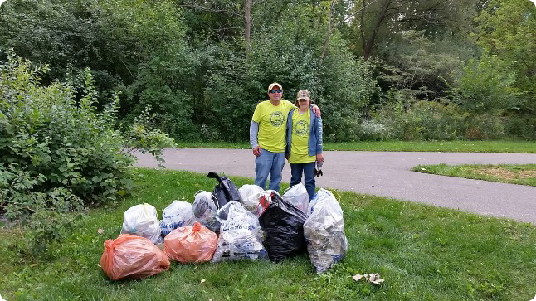
Conclusion and Call to Action
1
A Cleaner Future
The river cleaning robot represents a significant step towards restoring the health and vitality of our precious waterways.
2
Join the Movement
Together, we can make a difference by supporting the deployment of these robots and advocating for sustainable water management practices.
3
A Brighter Tomorrow
By harnessing the power of innovation and technology, we can create a greener, more sustainable world for generations to come.

Slide 12


